Slide 1

Milk POWDER Oscar Dowson odow003@aucklanduni.ac.nz Andy Philpott, Andrew Mason, Anthony Downward

Slide 2
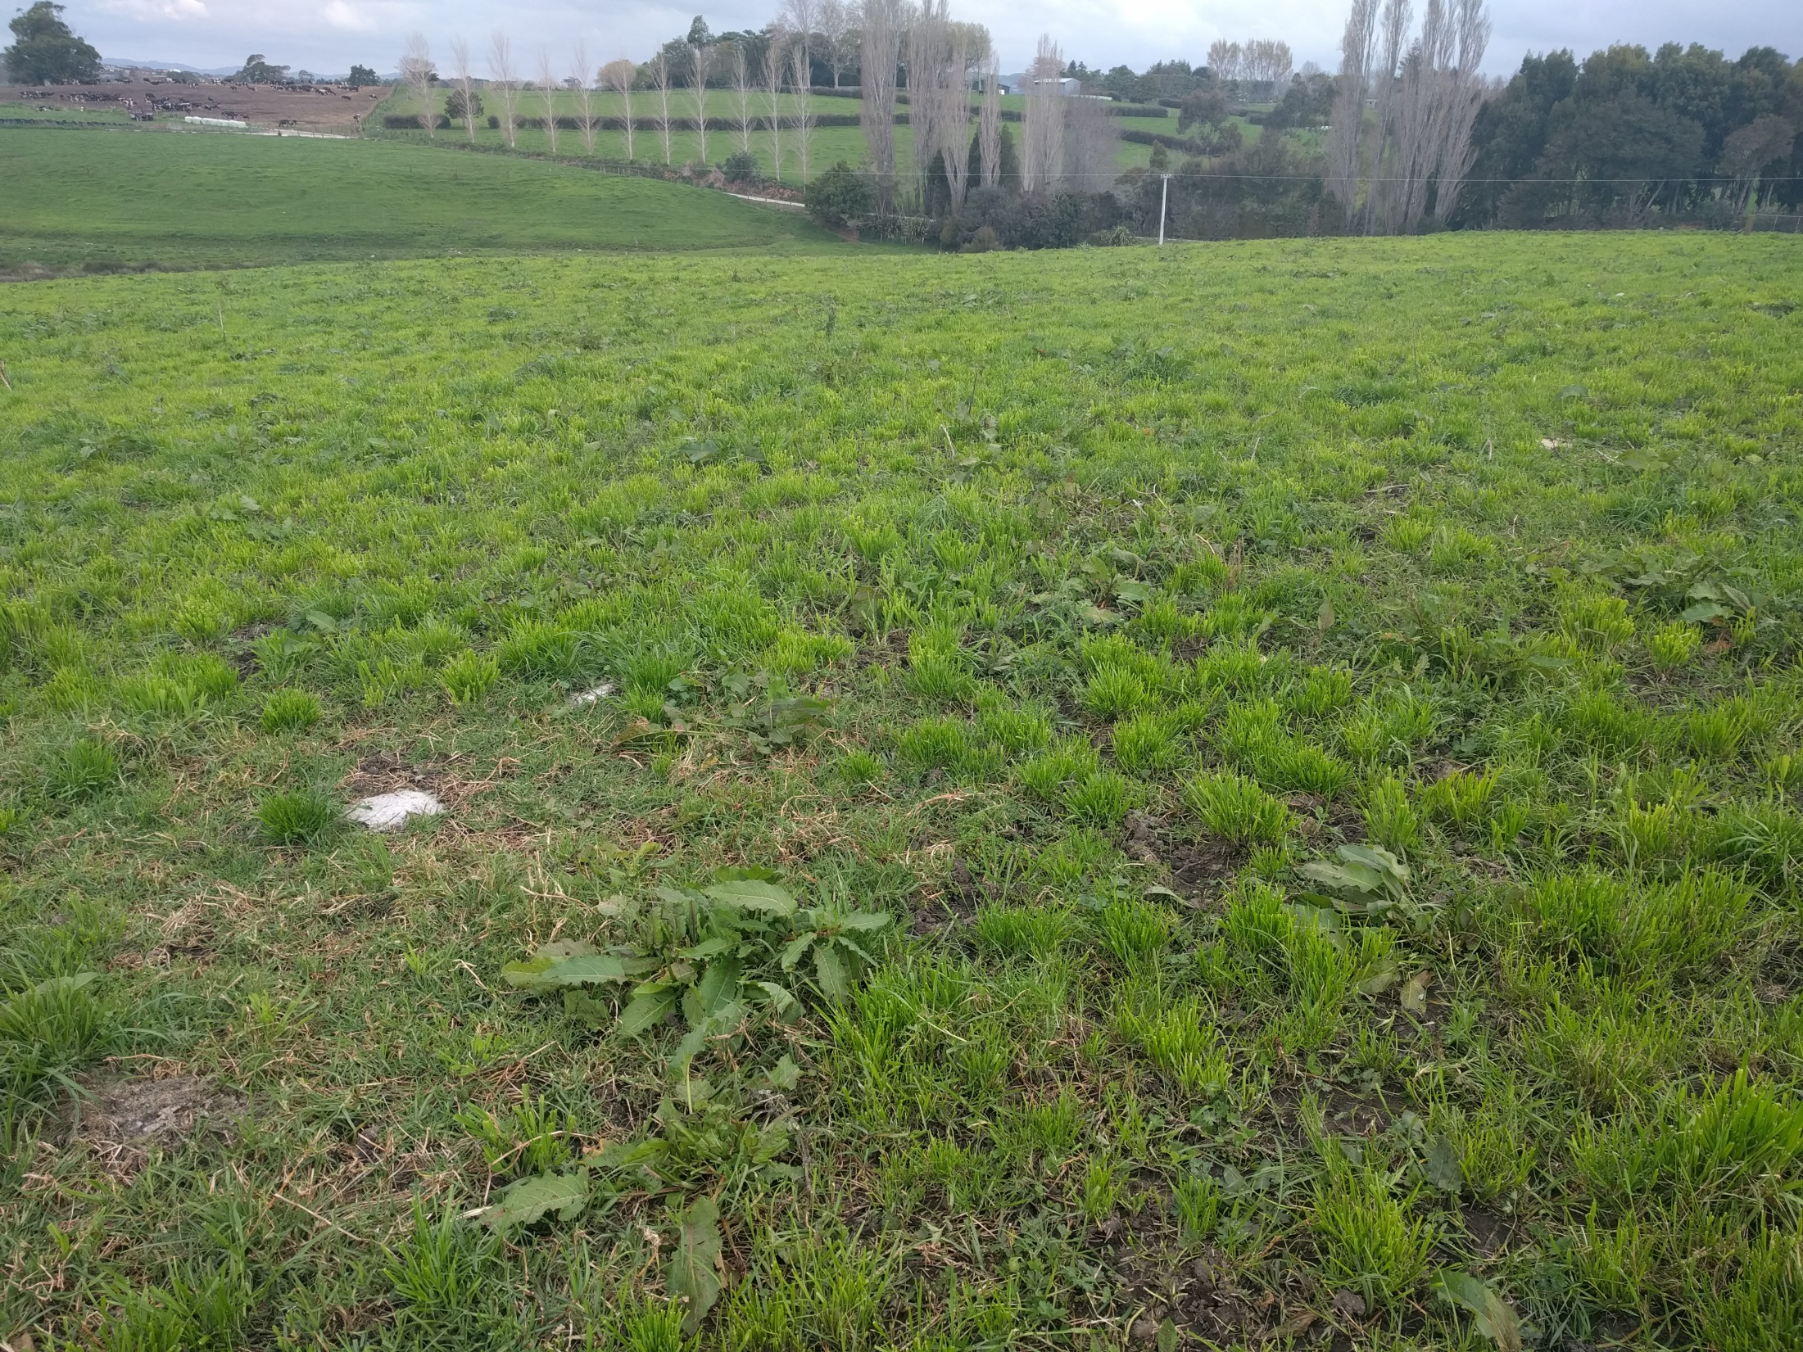

Slide 3
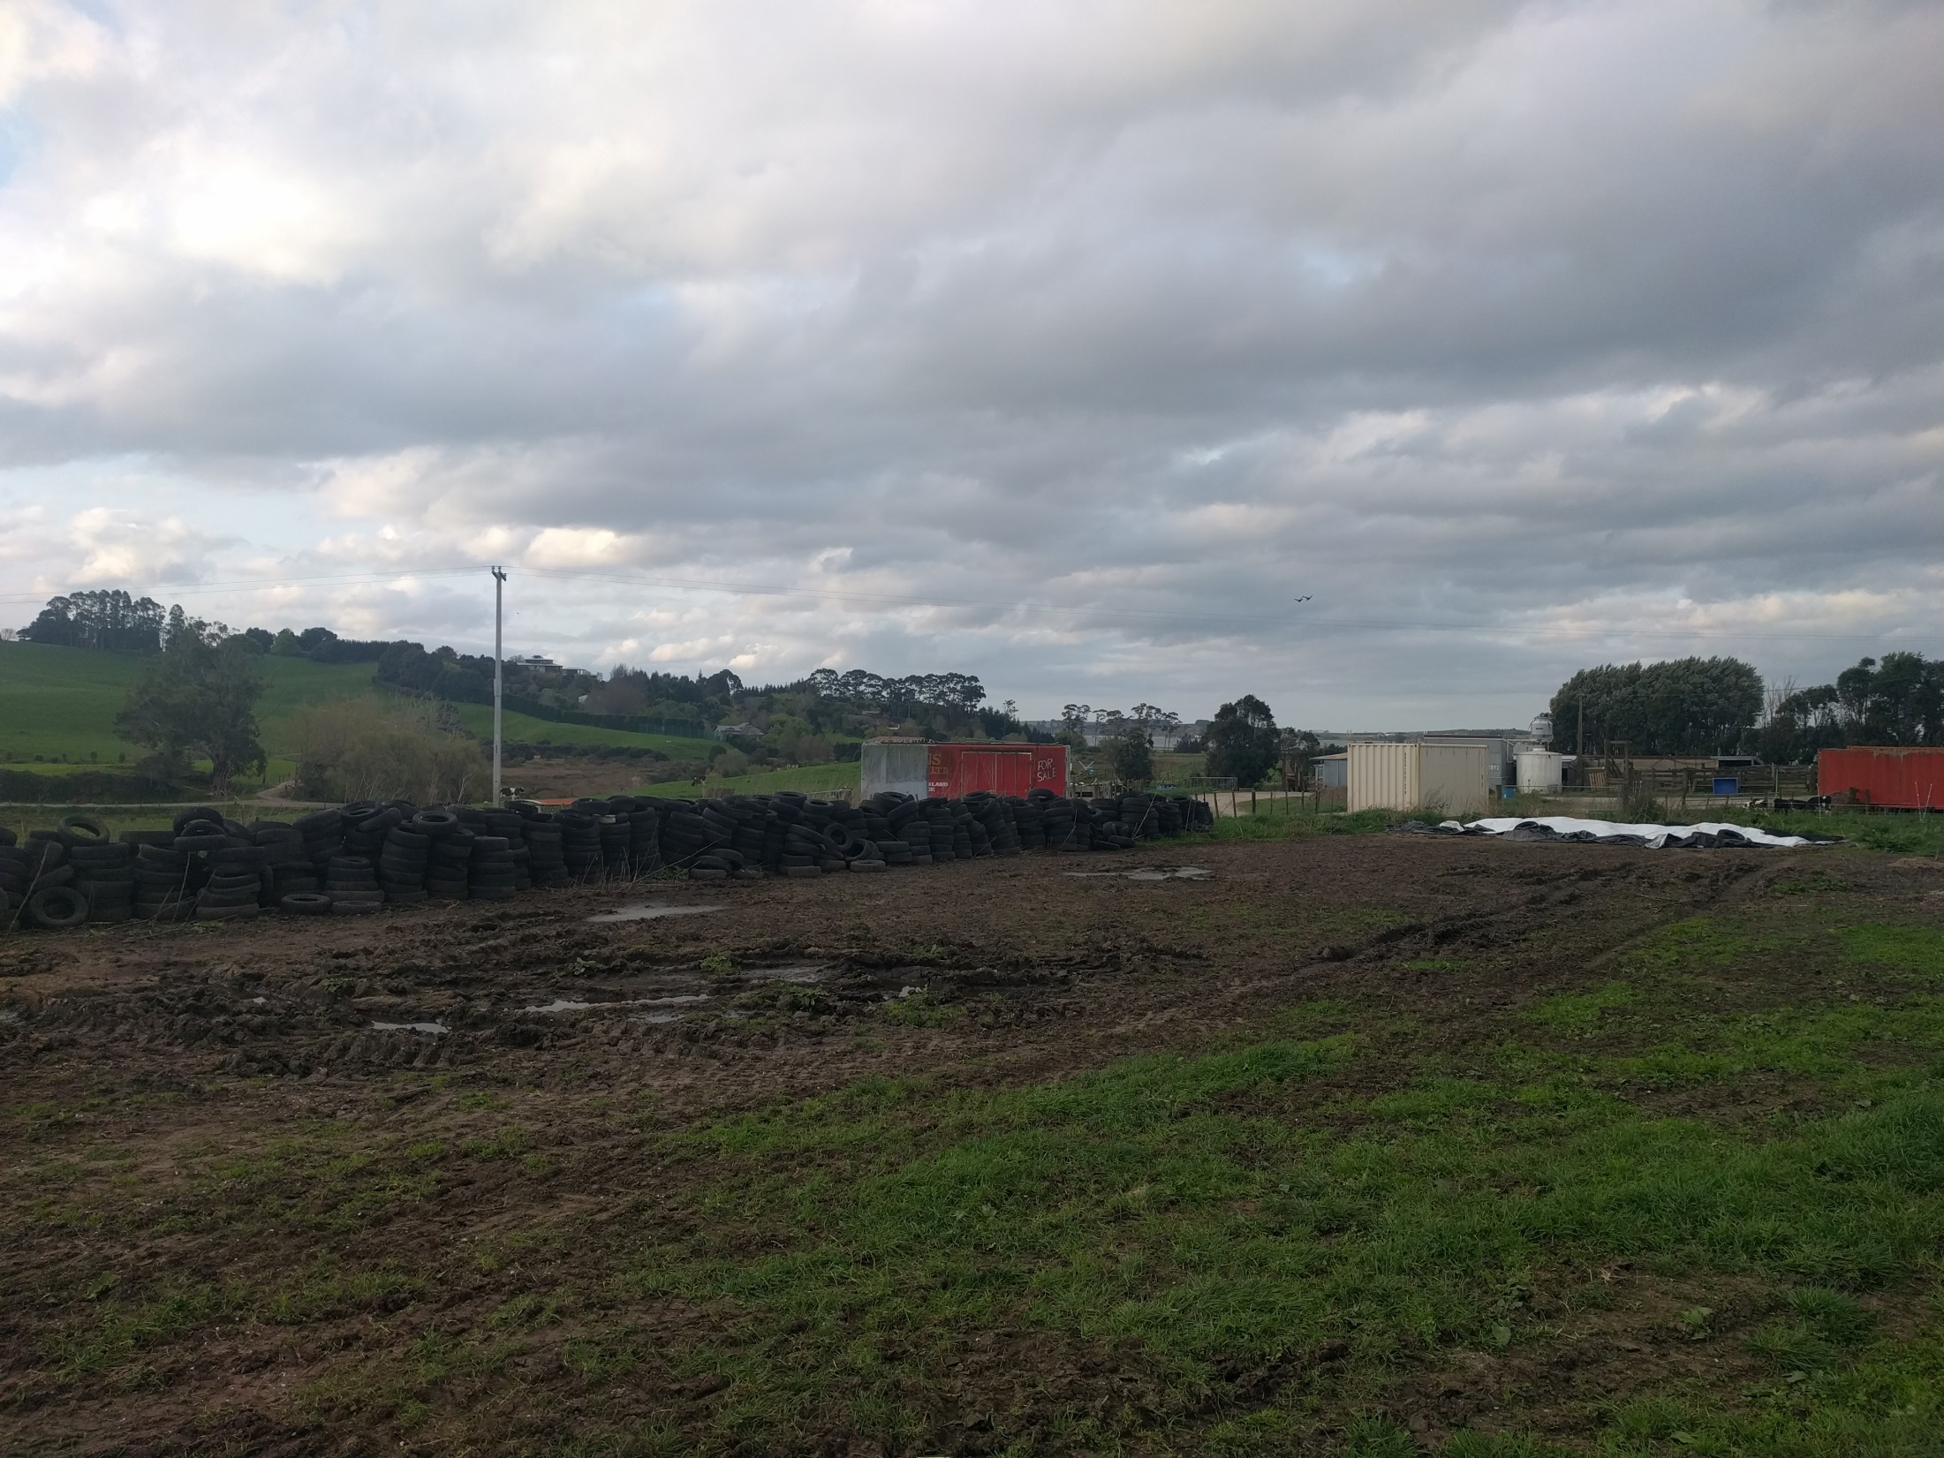

Slide 4
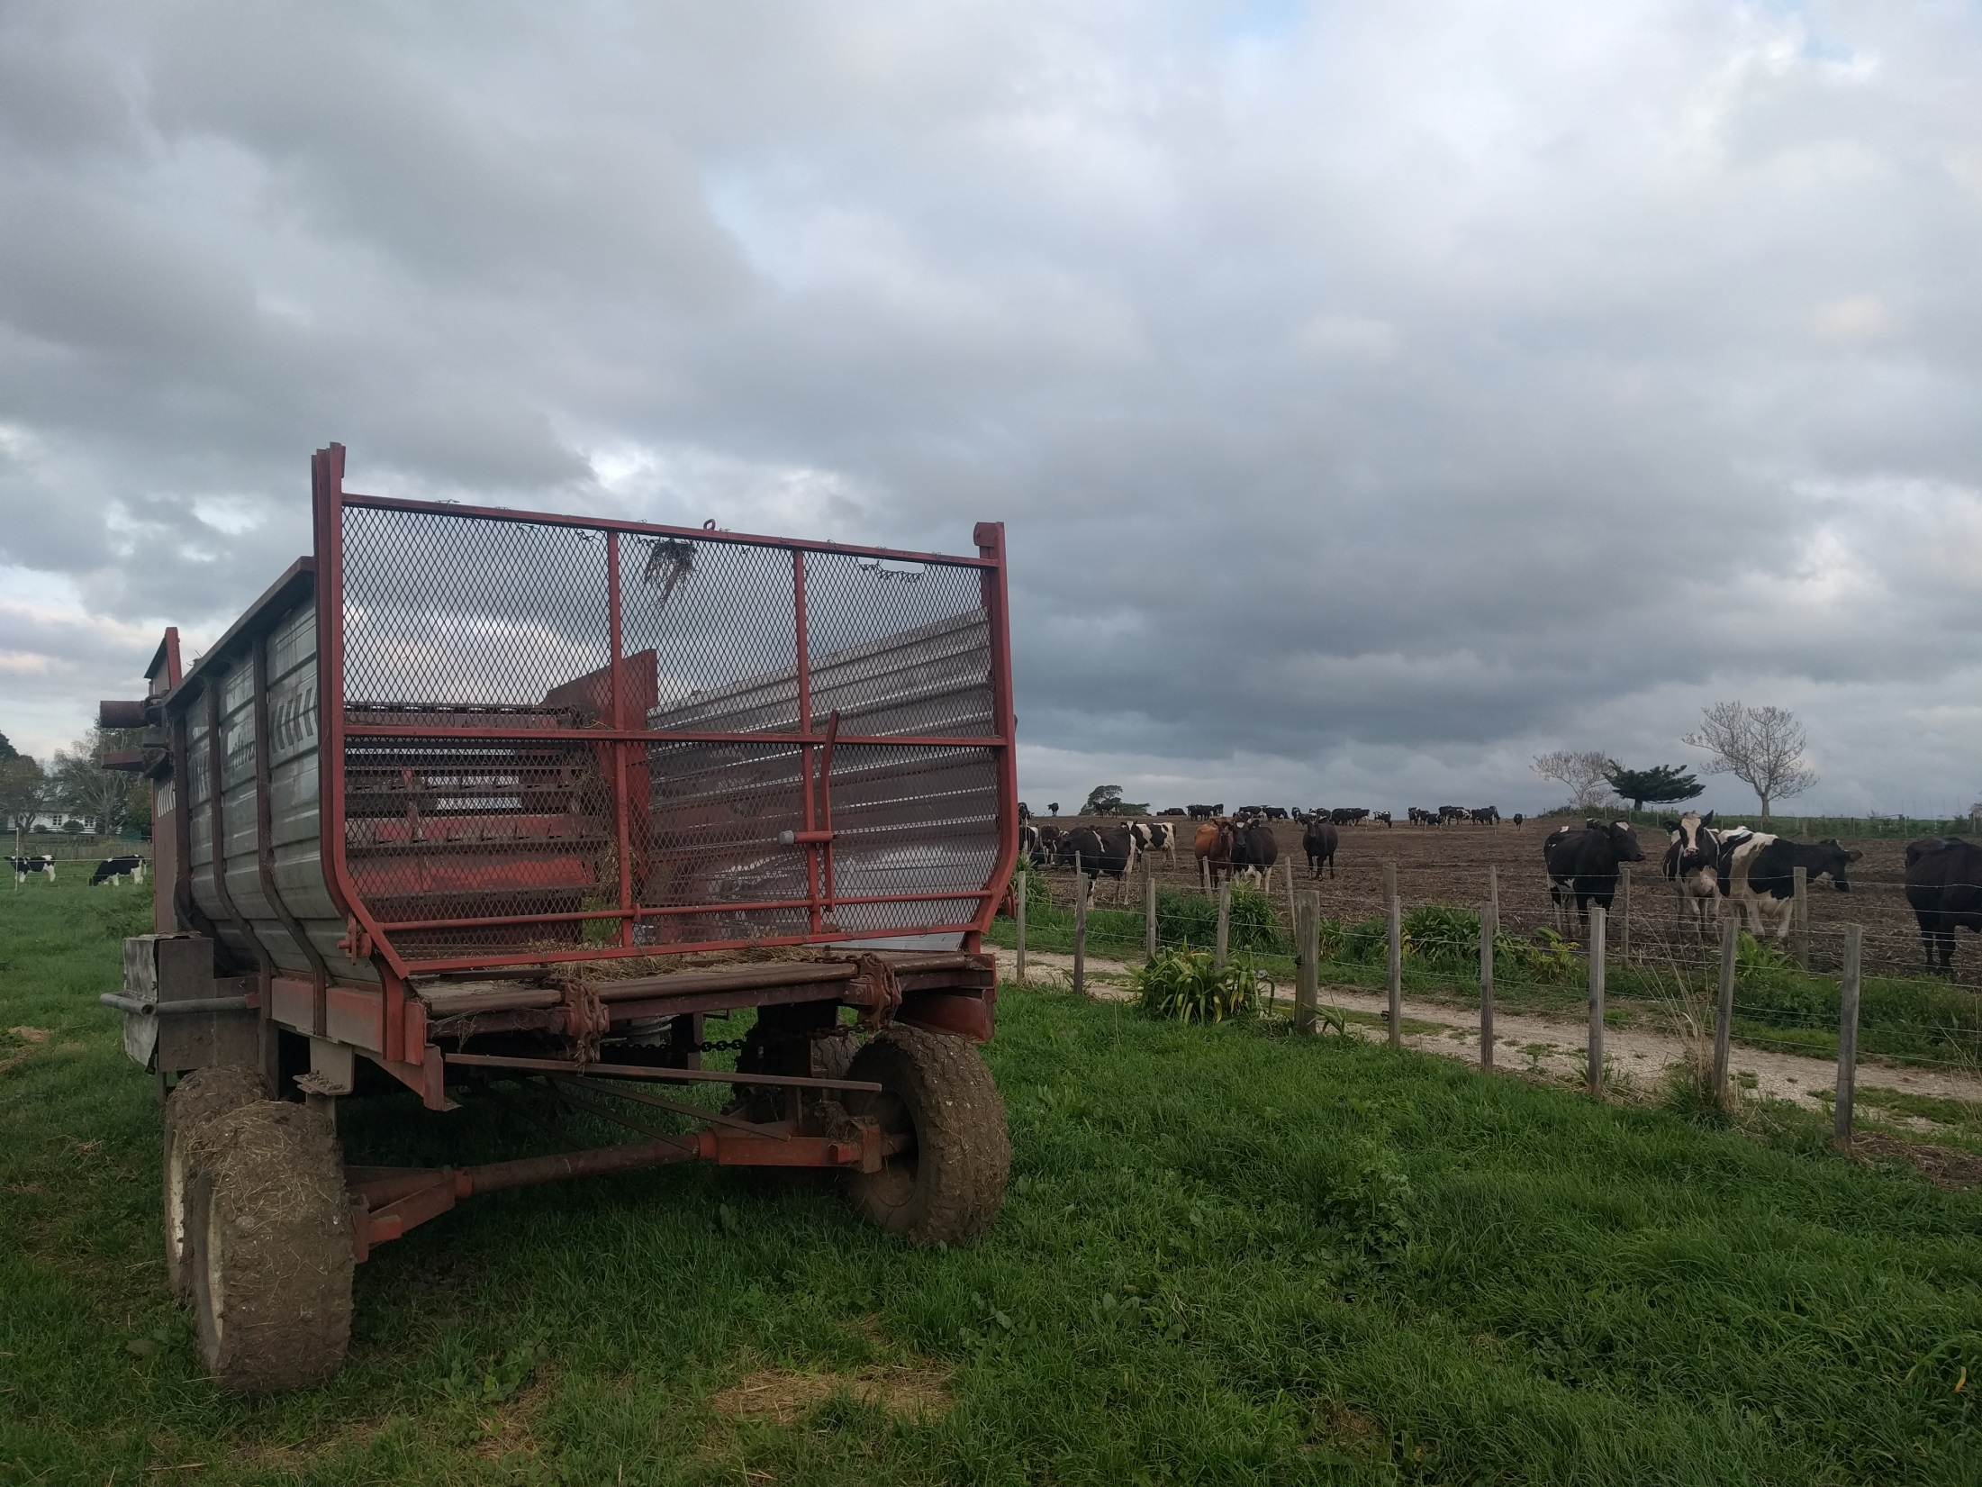
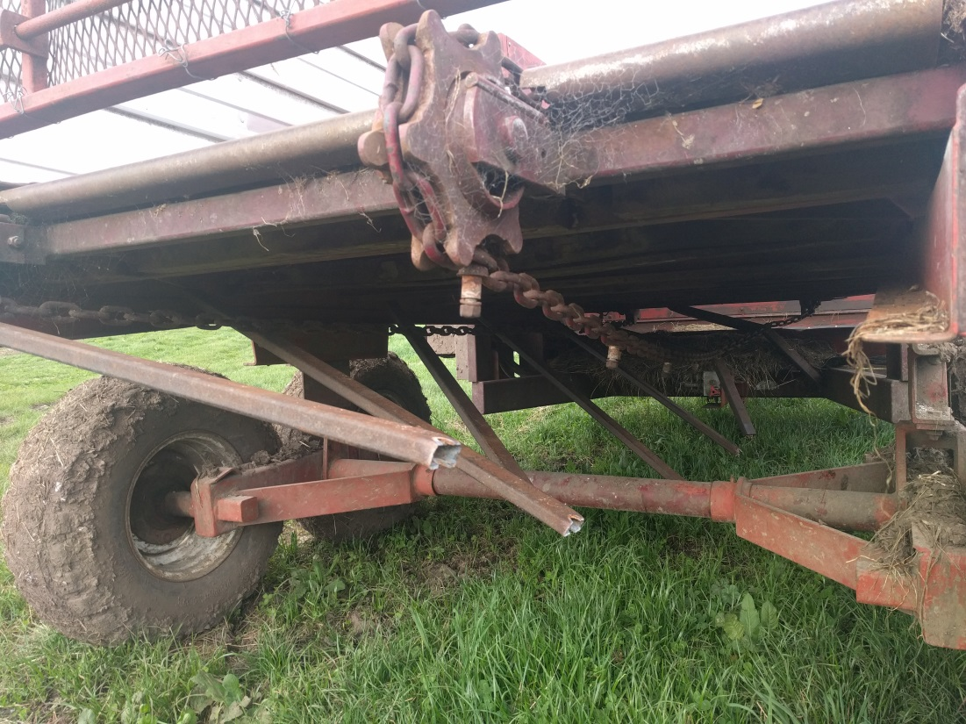

Slide 5
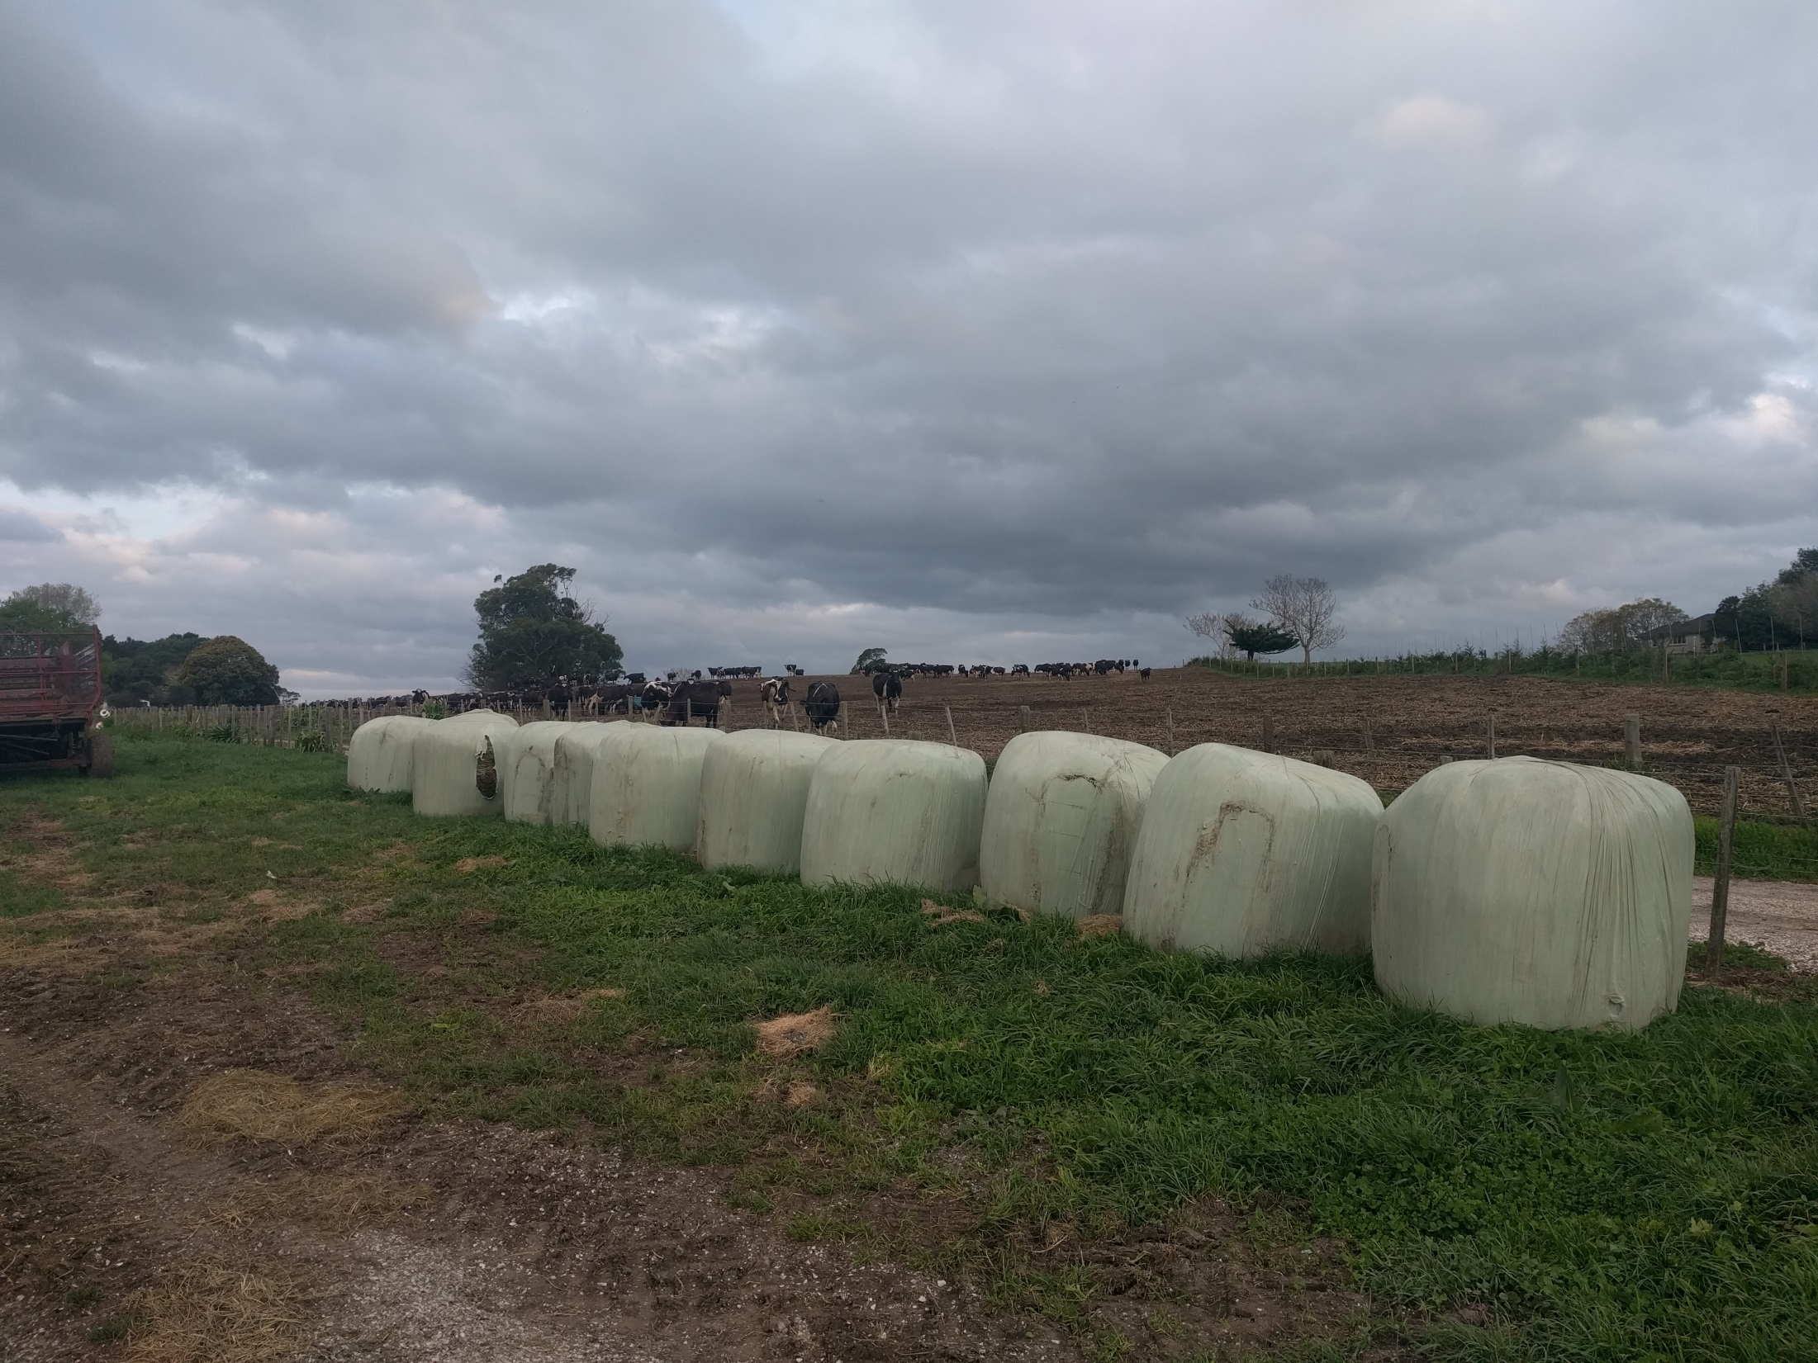

Slide 6
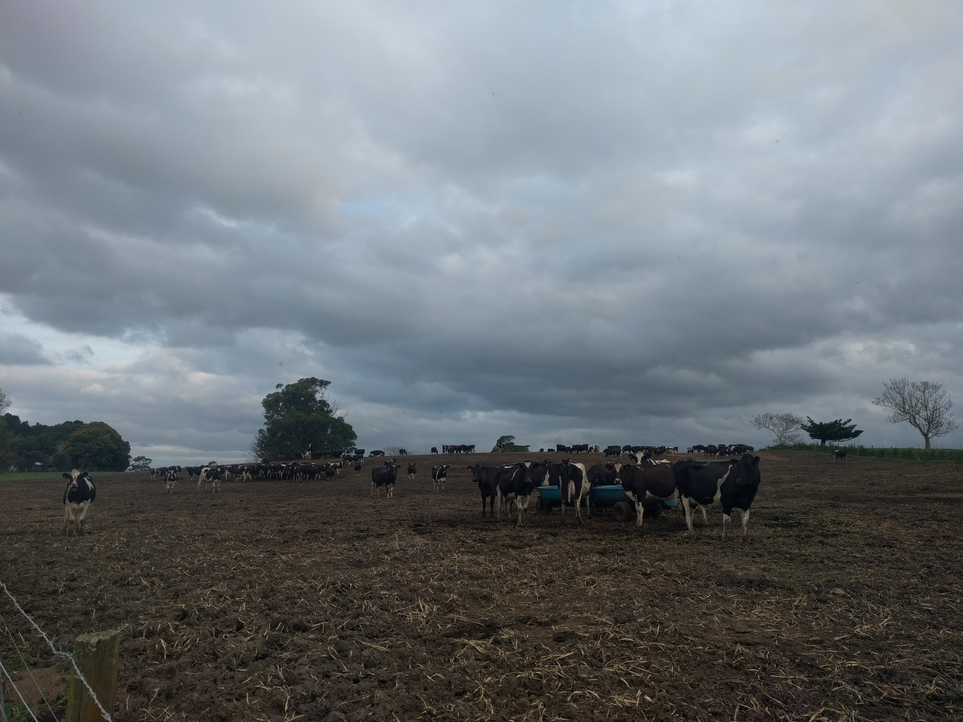

Slide 7
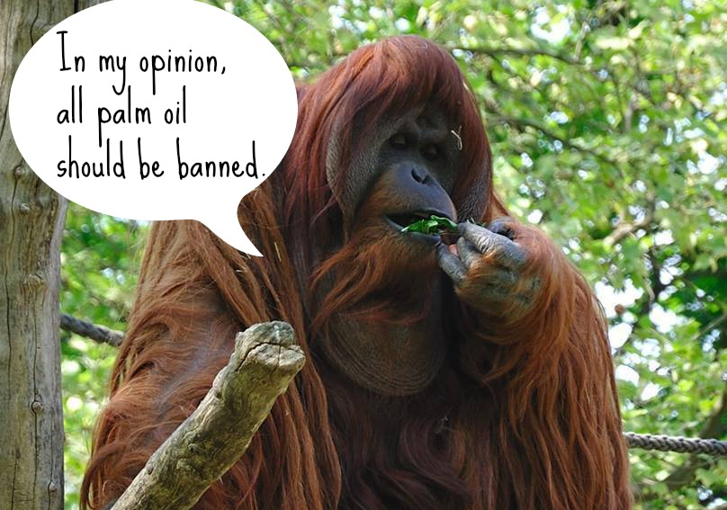

Slide 8
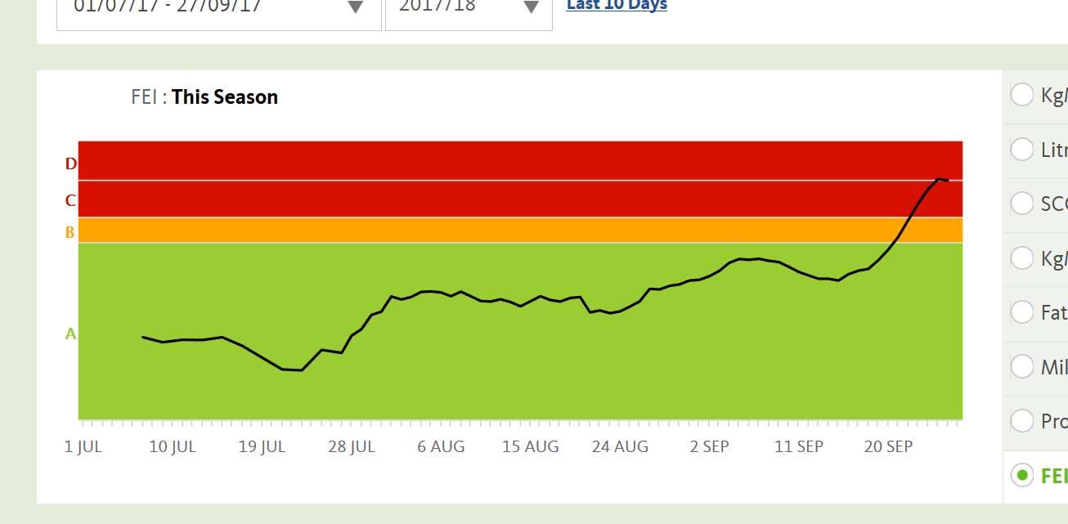

Slide 9
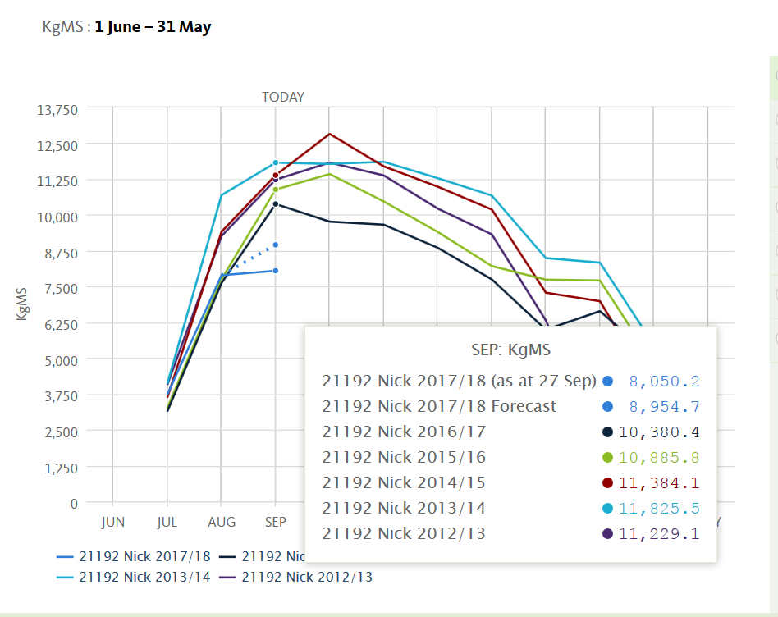

Slide 10
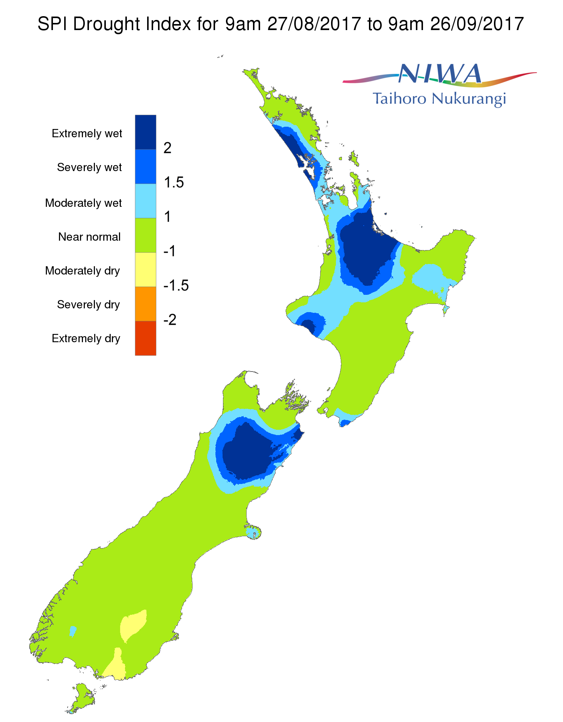
Our farm

Slide 11
What went wrong?
Good payout forecast
So maintained high stocking rate
Reasonable feed stocks on hand so didn’t buy more
Wet year (2x avg. rainfall) left paddocks damaged
Experience said: can’t have bad Summer, Autumn, Winter AND Spring right… the sun will come
Farm consultant’s advice: “don’t blink”

Slide 12
The Milk Production Optimiser incorporating Weather Dynamics and Economic Risk

Slide 13

Evaporation
Rainfall
Sunlight
Transpiration
Evaporation
potential
Temperature
Drainage

Slide 14
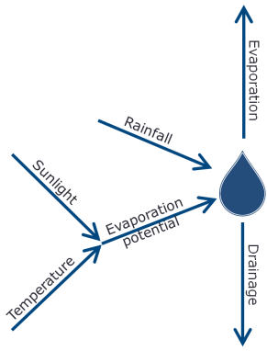

Growth
Fertiliser
Harvest
Transpiration
Feed
Nitrogen

Slide 15
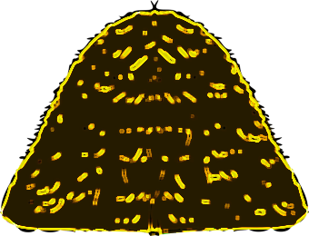
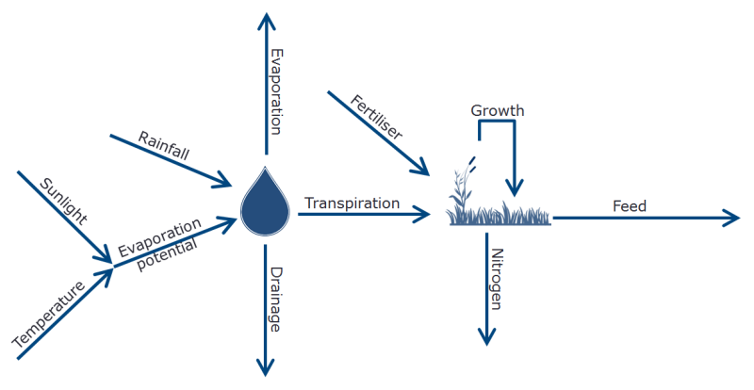
Buy
Harvest
Feed

Slide 16
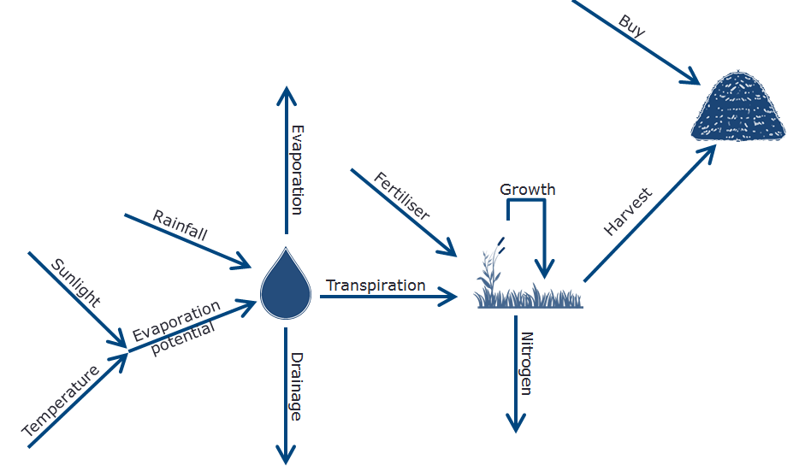
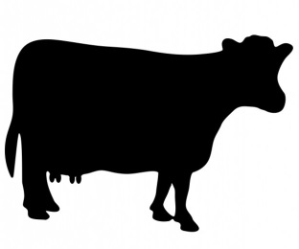
Feed
Feed
Feed
Feed
Dry
Milk
$
FGMP

Slide 17
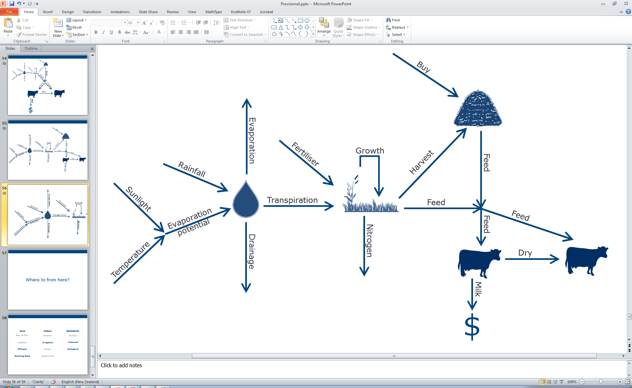
FGMP

Slide 18
Weather
Model
FGMP

Slide 19
Weather
Model
Plant
Model
FGMP

Slide 20
Weather
Model
Plant
Model
Production
Model
FGMP

Slide 21
Storage
Model
(Optional)
Weather
Model
Plant
Model
Production
Model
FGMP

Slide 22
Storage
Model
(Optional)
Weather
Model
Plant
Model
Production
Model
Price
Model
FGMP

Slide 23
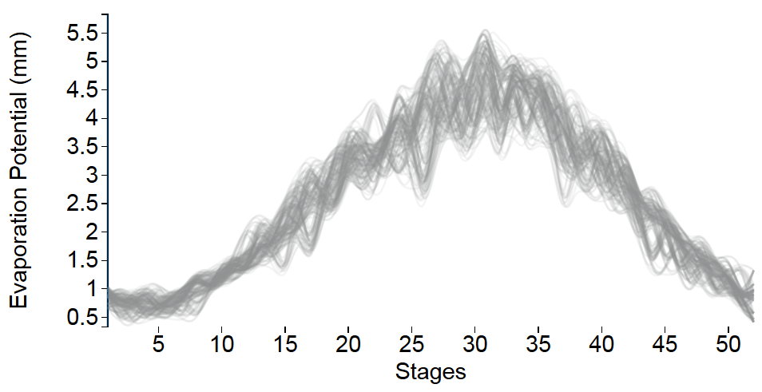
Evaporation Potential

Slide 24
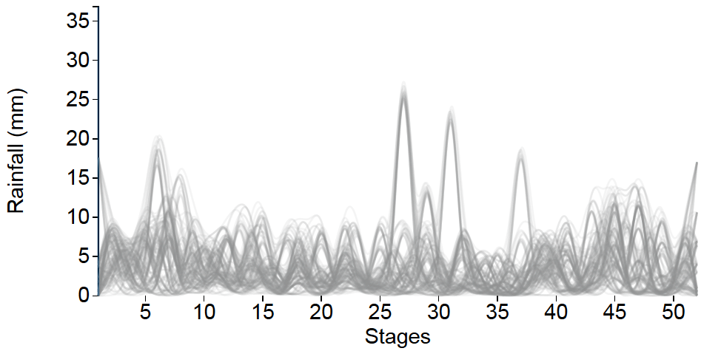
Rainfall

Slide 25
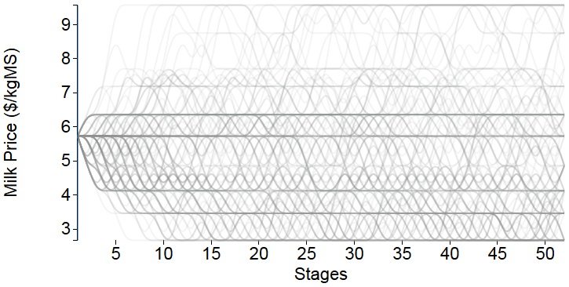
Milk Price

Slide 26
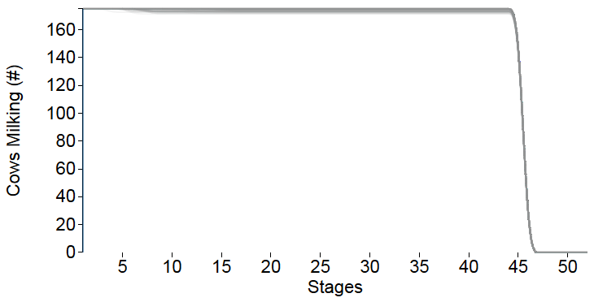
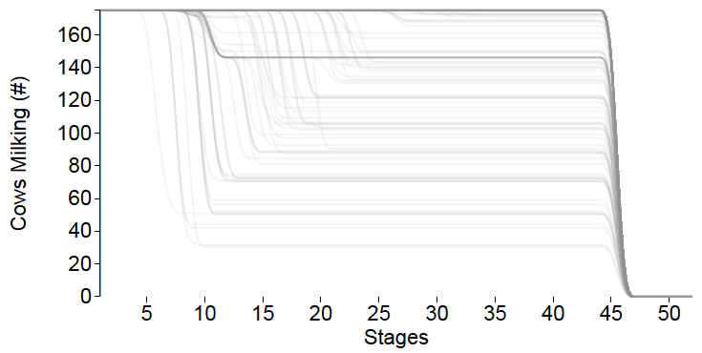
Dry off Decisions
Risk Neutral
Risk Averse

Slide 27
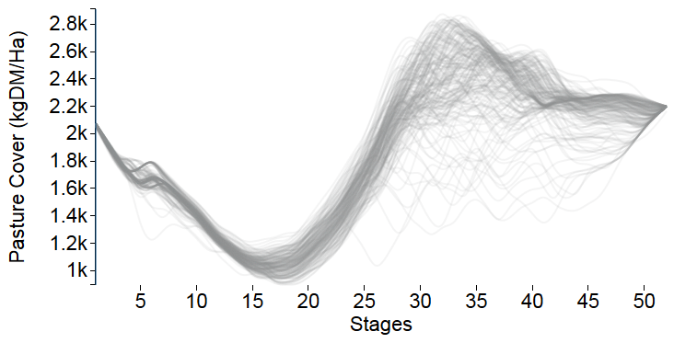
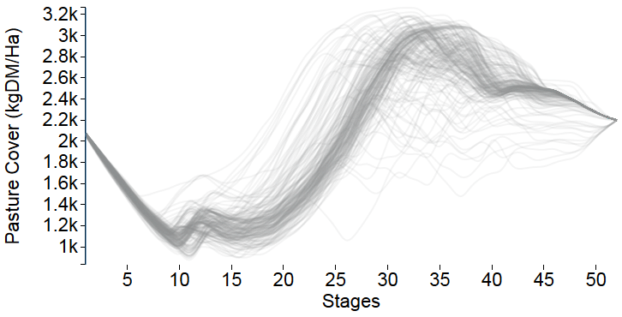
Pasture Management
Risk Neutral
Risk Averse

Slide 28
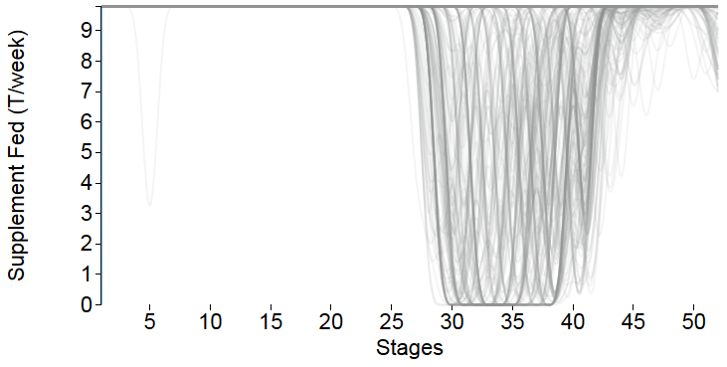
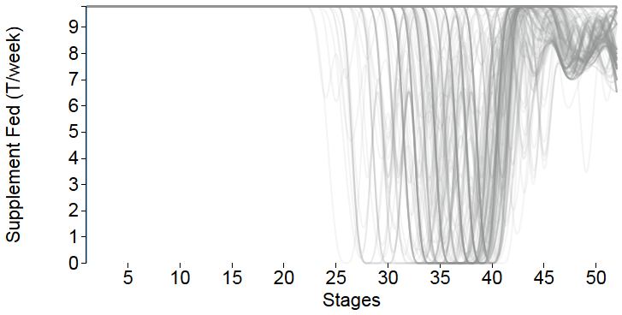
Supplementation
Risk Neutral
Risk Averse

Slide 29
Objective
Drying off cows early
Buying expensive
feed

Slide 30
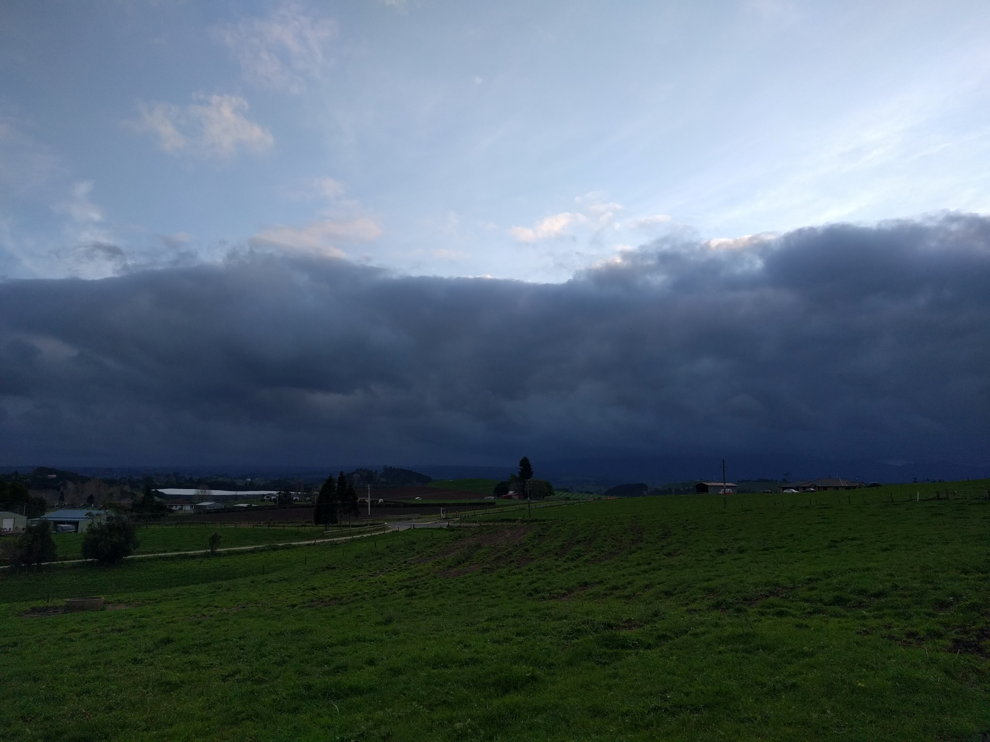

Slide 31
2015/16
1992/93

Slide 32
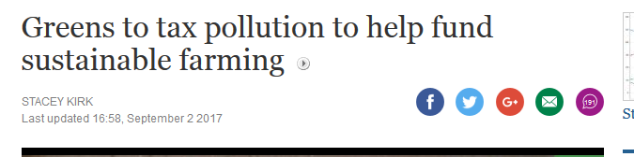

Slide 33
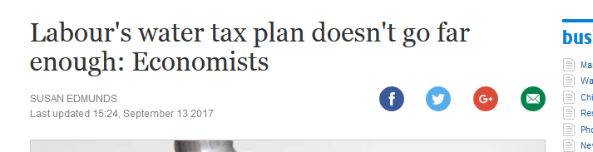

Slide 34
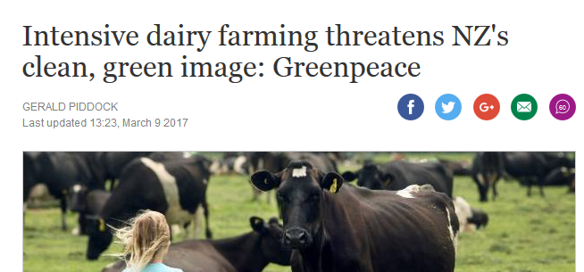

Slide 35
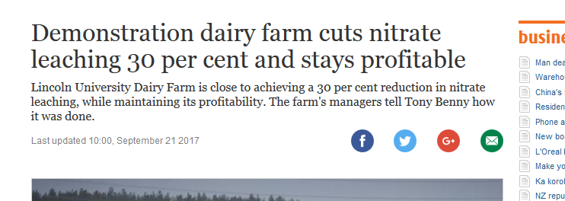

Slide 37
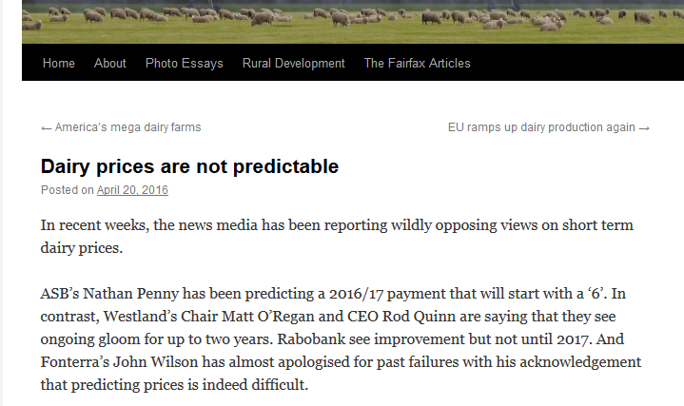
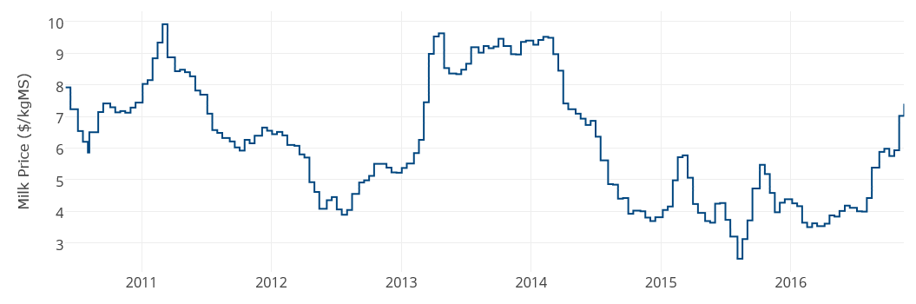
keithwoodford.wordpress.com

Slide 38
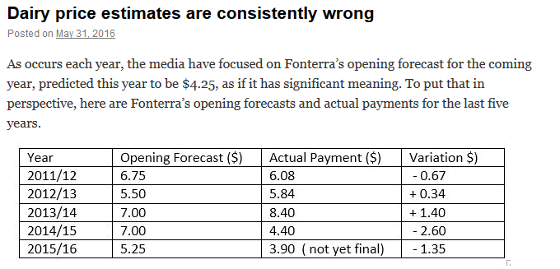
keithwoodford.wordpress.com

